Slide 1

Advanced Analytical Theory and Methods: MapReduce and Hadoop
Author : FU
Date : Mar-2022

Slide 2
Objectives
After studying this chapter, the student should be able to understand the key concepts:
Hadoop
Hadoop Ecosystem
MapReduce
NoSQL

Slide 3
Content
1 Analytics for Unstructured Data
2 The Hadoop Ecosystem
3 NoSQL

Slide 4
1 Analytics for Unstructured Data
Prior to conducting data analysis required data must be collected and processed to extract the useful information. Degree of initial processing and data preparation depends on the volume of data, as well as how straightforward it is to understand the structure of the data
Four types of data structures discussed
Structured: A specific and consistent format (for example, a data table)
Semi-structured: A self-describing format (for example, an XML file)
Quasi-structured: A somewhat inconsistent format (for example, a hyperlink)
Unstructured: An inconsistent format (for example, text or video)

Slide 5
1.1 Use Cases
MapReduce paradigm offers the means to break a large task into smaller tasks, run tasks in parallel, and consolidate the outputs of the individual tasks into the final output.
Apache Hadoop includes a software implementation of MapReduce.
IBM Watson
LinkedIn
Yahoo!

Slide 6
1.2 MapReduce 1/2
MapReduce paradigm provides the means to break a large task into smaller tasks, run the tasks in parallel, and consolidate the outputs of the individual tasks into the final output.
MapReduce consists of two basic parts—a map step and a reduce step—detailed as follows:
Map:
Applies an operation to a piece of data
Provides some intermediate output
Reduce:
Consolidates the intermediate outputs from the map steps
Provides the final output
Each step uses key/value pairs, denoted as <key, value>, as input and output. It is useful to think of the key/value pairs as a simple ordered pair. The pairs can take fairly complex forms.

Slide 7
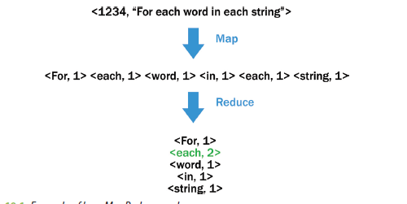
1.2 MapReduce 2/2
FIGURE 10-1 Example of how MapReduce works
Map step parses the provided text string into individual words and emits a set of key/value pairs of the form <word, 1>.
For each unique key—in this example, word—the reduce step sums the 1 values and outputs the <word, count> key/value pairs. Because the word each appeared twice in the given line of text, the reduce step provides a corresponding key/value pair of <each, 2>.
Expanding on the word count example, the final output of a MapReduce process applied to a set of documents might have the key as an ordered pair and the value as an ordered tuple of length 2n. A possible representation of such a key/value pair follows:
<(filename, datetime),(word1,5, word2,7,... , wordn,6)>

Slide 8
1.3 Apache Hadoop 1/2
MapReduce is a simple paradigm, not as easy to implement, especially in a distributed system.
Executing a MapReduce job (the MapReduce code run against some specified data) requires the management and coordination of several activities:
MapReduce jobs need to be scheduled based on the system’s workload.
Jobs need to be monitored and managed to ensure that any encountered errors are properly handled so that the job continues to execute if the system partially fails.
Input data needs to be spread across the cluster.
Map step processing of the input needs to be conducted across the distributed system, preferably on the same machines where the data resides.
Intermediate outputs from the numerous map steps need to be collected and provided to the proper machines for the reduce step execution.
Final output needs to be made available for use by another user, another application, or perhaps another MapReduce job.

Slide 9
1.3 Apache Hadoop 2/2
Apache Hadoop handles these activities and more. Many of these activities are transparent to the developer/user.
Origins of Hadoop began as a search engine called Nutch, developed by Doug Cutting and Mike Cafarella.
Based on two Google papers, versions of MapReduce and the Google File System were added to Nutch in 2004.
In 2006, Yahoo! hired Cutting, who helped to develop Hadoop based on the code in Nutch.
Name “Hadoop” came from the name of Cutting’s child’s stuffed toy elephant that also inspired the well-recognized symbol for the Hadoop project.

Slide 10
Hadoop Distributed File System (HDFS) 1/4
Hadoop Distributed File System (HDFS) is a file system that provides the capability to distribute data across a cluster to take advantage of the parallel processing of MapReduce.
HDFS is not an alternative to common file systems, such as ext3, ext4, and XFS. HDFS depends on each disk drive’s file system to manage the data being stored to the drive media.
HDFS breaks the file, say, into 64 MB blocks and stores the blocks across the cluster. So, if a file size is 300 MB, the file is stored in five blocks: four 64 MB blocks and one 44 MB block. If a file size is smaller than 64 MB, the block is assigned the size of the file.
Whenever possible, HDFS attempts to store the blocks for a file on different machines so the map step can operate on each block of a file in parallel.
By default HDFS creates three copies of each block across the cluster to provide the necessary redundancy in case of a failure. If a machine fails, HDFS replicates an accessible copy of the relevant data blocks to another available machine

Slide 11
Hadoop Distributed File System (HDFS) 2/4
HDFS is also rack aware. It distributes the blocks across several equipment racks to prevent an entire rack failure from causing a data unavailable event.
Three copies of each block allow Hadoop some flexibility in determining which machine to use for the map step on a particular block.
For example, an idle or underutilized machine that contains a data block to be processed can be scheduled to process that data block.
To manage the data access, HDFS utilizes three Java daemons (background processes): NameNode, DataNode, and Secondary NameNode.
NameNode daemon determines and tracks where the various blocks of a data file are stored.
DataNode daemon manages the data stored on each machine. If a client application wants to access a particular file stored in HDFS, Application contacts the NameNode, and NameNode provides the application with the locations of the various blocks for that file. The application then communicates with the appropriate DataNodes to access the file.

Slide 12
Hadoop Distributed File System (HDFS) 3/4
Each DataNode periodically builds a report about the blocks stored on the DataNode and sends the report to the NameNode.
If one or more blocks are not accessible on a DataNode, the NameNode ensures that an accessible copy of an inaccessible data block is replicated to another machine.
For performance reasons, NameNode resides in a machine’s memory. Because NameNode is critical to the operation of HDFS,
NameNode is viewed as a single point of failure in the Hadoop environment. To minimize the chance of a NameNode failure and to improve performance, the NameNode is typically run on a dedicated machine.
Secondary NameNode (A third daemon) provides the capability to perform some of the NameNode tasks to reduce the load on the NameNode. Such tasks include updating the file system image with the contents of the file system edit logs.

Slide 13
Hadoop Distributed File System (HDFS) 4/4
It is important to note that the Secondary NameNode is not a backup or redundant NameNode.
If a NameNode outage, NameNode must be restarted and initialized with the last file system image file and the contents of the edits logs. The latest versions of Hadoop provide an HDFS High Availability (HA) feature. This feature enables the use of two NameNodes: one in an active state, and the other in a standby state. If an active NameNode fails, the standby NameNode takes over. When using the HDFS HA feature, a Secondary NameNode is unnecessary
Figure 10-2 illustrates a Hadoop cluster with ten machines and the storage of one large file requiring three HDFS data blocks. Furthermore, this file is stored using triple replication.
Master nodes: machines running the NameNode and the Secondary NameNode.
Worker nodes: machines running the DataNodes

Slide 14
Structuring a MapReduce Job in Hadoop 1/3
A typical MapReduce program in Java consists of three classes: driver, mapper, and reducer.
Driver provides details such as input file locations, the provisions for adding the input file to the map task, the names of the mapper and reducer Java classes, and the location of the reduce task output.
Mapper provides the logic to be processed on each data block corresponding to the specified input files in the driver code.
For example, in the word count MapReduce example provided earlier, a map task is instantiated on a worker node where a data block resides.
Each map task processes a fragment of the text, line by line, parses a line into words, and emits <word, 1> for each word, regardless of how many times word appears in the line of text. The key/value pairs are stored temporarily in the worker node’s memory (or cached to the node’s disk).

Slide 15
Structuring a MapReduce Job in Hadoop 2/3
FIGURE 10-2 A file stored in HDFS

Slide 16
Structuring a MapReduce Job in Hadoop 3/3
Next, the key/value pairs are processed by the built-in shuffle and sort functionality based on the number of reducers to be executed.
From the various map task outputs, for each unique key, arrays (lists in Java) of the associated values in the key/value pairs are constructed. Also, Hadoop ensures that the keys are passed to each reducer in sorted order. In Figure 10-3, <each,(1,1)> is the first key/value pair processed, followed alphabetically by <For,(1)> and the rest of the key/value pairs until the last key/value pair is passed to the reducer. The ( ) denotes a list of values which, in this case, is just an array of ones.
Reducer processes the values for each key and emits a key/value pair as defined by the reduce logic. The output is then stored in HDFS like any other file in, say, 64 MB blocks replicated three times across the nodes.

Slide 17
Additional Considerations in Structuring a MapReduce Job 1/3
A combiner is a useful option to apply, when possible, between the map task and the shuffle and sort. Typically, the combiner applies the same logic used in the reducer, but it also applies this logic on the output of each map task.
In the word count example, a combiner sums up the number of occurrences of each word from a mapper’s output. Figure 10-4 illustrates how a combiner processes a single string in the simple word count example.
FIGURE 10-3 Shuffle and sort

Slide 18
Additional Considerations in Structuring a MapReduce Job 2/3
In a production setting, instead of ten thousand possible <the, 1> key/value pairs being emitted from the map task to the Shuffle and Sort, the combiner emits one <the, 10000> key/value pair.
Reduce step still obtains a list of values for each word, but instead of receiving a list of up to a million ones list(1,1,. . .,1) for a key, the reduce step obtains a list, such as list(10000,964,. . .,8345), which might be as long as the number of map tasks that were run. The use of a combiner minimizes the amount of intermediate map output that the reducer must store, transfer over the network, and process.
FIGURE 10-4 Using a combiner

Slide 19
Additional Considerations in Structuring a MapReduce Job 3/3
Partitioner: another useful option. It determines the reducers that receive keys and the corresponding list of values.
Figure 10-5 shows that a partitioner can send every word that begins with a vowel to one reducer and the other words that begin with a consonant to another reducer.
FIGURE 10-5 Using a custom partitioner
Notes:
As a more practical example, a user could use a partitioner to separate the output into separate files
for each calendar year for subsequent analysis. Also, a partitioner could be used to ensure that the workload
is evenly distributed across the reducers. For example, if a few keys are known to be associated with
a large majority of the data, it may be useful to ensure that these keys go to separate reducers to achieve
better overall performance. Otherwise, one reducer might be assigned the majority of the data, and the
MapReduce job will not complete until that one long-running reduce task completes.

Slide 20
Developing and Executing a Hadoop MapReduce Program
To develop a Hadoop MapReduce program is to write Java code using an Interactive Development Environment (IDE) tool such as Eclipse .
Beyond learning the mechanics of submitting a MapReduce job, three key challenges to a new Hadoop developer are defining the logic of the code to use the MapReduce paradigm; learning the Apache Hadoop Java classes, methods, and interfaces; and implementing the driver, map, and reduce functionality in Java.
One option is to use the Hadoop Streaming API, which allows the user to write and run Hadoop jobs with no direct knowledge of Java. However, knowledge of some other programming language, such as Python, C, or Ruby, is necessary. Apache Hadoop provides the Hadoop-streaming.jar file that accepts the HDFS paths for the input/output files and the paths for the files that implement the map and reduce functionality

Slide 21
Yet Another Resource Negotiator (YARN) 1/2
Apache Hadoop continues to undergo further development and frequent updates. An important change was to separate the MapReduce functionality from the functionality that manages the running of the jobs and the associated responsibilities in a distributed environment. This rewrite is sometimes called MapReduce 2.0, or Yet Another Resource Negotiator (YARN)
YARN separates the resource management of the cluster from the scheduling and monitoring of jobs running on the cluster. YARN implementation makes it possible for paradigms other than MapReduce to be utilized in Hadoop environments. For example, a Bulk Synchronous Parallel (BSP) model may be more appropriate for graph processing than MapReduce is.
Apache Hama, which implements the BSP model, is one of several applications being modified to utilize the power of YARN

Slide 22
Yet Another Resource Negotiator (YARN) 2/2
YARN replaces the functionality previously provided by the JobTracker and TaskTracker daemons.
In earlier releases of Hadoop, a MapReduce job is submitted to the JobTracker daemon. JobTracker communicates with the NameNode to determine which worker nodes store the required data blocks for the MapReduce job.
JobTracker then assigns individual map and reduce tasks to the TaskTracker running on worker nodes. To optimize performance, each task is preferably assigned to a worker node that is storing an input data block. TaskTracker periodically communicates with the JobTracker on the status of its executing tasks. If a task appears to have failed, the JobTracker can assign the task to a different TaskTracker.

Slide 23
2 The Hadoop Ecosystem
Hadoop’s popularity has spawned proprietary and open source tools to make Apache Hadoop easier to use and provide additional functionality and features
The following Hadoop-related Apache projects:
Pig: Provides a high-level data-flow programming language
Hive: Provides SQL-like access
Mahout: Provides analytical tools
HBase: Provides real-time reads and writes

Slide 24
2.1 Pig 1/4
Apache Pig consists of a data flow language, Pig Latin, and an environment to execute the Pig code.
Main benefit of using Pig is to utilize the power of MapReduce in a distributed system, while simplifying the tasks of developing and executing a MapReduce job. In In most cases, it is transparent to the user that a MapReduce job is running in the background when Pig commands are executed.
This abstraction layer on top of Hadoop simplifies the development of code against data in HDFS and makes MapReduce more accessible to a larger audience
Like Hadoop, Pig’s origin began at Yahoo! in 2006. Pig was transferred to the Apache Software Foundation in 2007 and had its first release as an Apache Hadoop subproject in 2008. As Pig evolves over time, three main characteristics persist: ease of programming, behind-the-scenes code optimization, and extensibility of capabilities

Slide 25

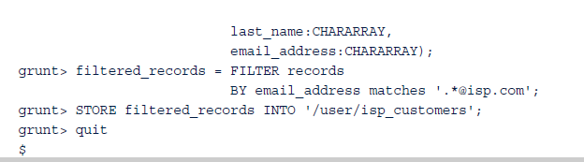
2.1 Pig 2/4
With Apache Hadoop and Pig already installed, the basics of using Pig include entering the Pig execution environment by typing pig at the command prompt and then entering a sequence of Pig instruction lines at the grunt prompt.
An example of Pig-specific commands:

Slide 26
2.1 Pig 3/4
Provides for the execution of several common data manipulations, such as inner and outer joins between two or more files (tables), as would be expected in a typical relational database.
Writing these joins explicitly in MapReduce using Hadoop would be quite involved and complex. Pig also provides a GROUP BY functionality that is similar to the Group By functionality offered in SQL.
Provides many built-in functions that are easily utilized in Pig code. Table 10-1 includes several useful functions by category.

Slide 27
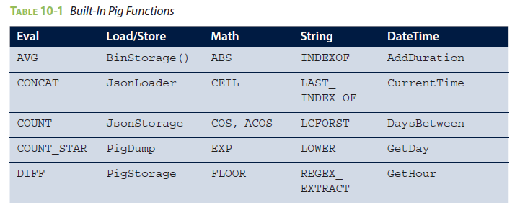
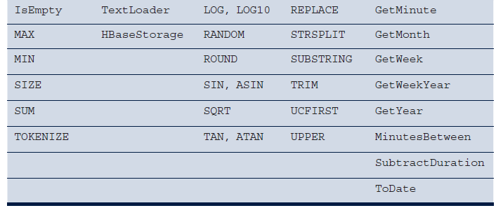
2.1 Pig 4/4

Slide 28
2.2 Hive 1/6
Apache Hive enables users to process data without explicitly writing MapReduce code. One key difference to Pig is that the Hive language, HiveQL (Hive Query Language), resembles Structured Query Language (SQL) rather than a scripting language
A Hive table structure consists of rows and columns. The rows typically correspond to some record, transaction, or particular entity (for example, customer) detail. The values of the corresponding columns represent the various attributes or characteristics for each row.
Hadoop and its ecosystem are used to apply some structure to unstructured data. Therefore, if a table structure is an appropriate way to view the restructured data, Hive may be a good tool to use.

Slide 29
2.2 Hive 2/6
Consider using Hive if
Has experience with SQL and data is already in HDFS
May be how data will be updated or added to the Hive tables. If data will simply be added to a table periodically, Hive works well, but if there is a need to update data in place, it may be beneficial to consider another tool, such as HBase
Hive’s performance may be better in certain applications than a conventional SQL database, but not intended for real-time querying. A Hive query is first translated into a MapReduce job, which is then submitted to the Hadoop cluster.
Like Pig, Hive is intended for batch processing.

Slide 30

2.2 Hive 3/6
Consider using Hive when the following conditions exist:
Data easily fits into a table structure.
Data is already in HDFS. (Note: Non-HDFS files can be loaded into a Hive table.)
Developers are comfortable with SQL programming and queries.
There is a desire to partition datasets based on time. (For example, daily updates are added to the Hive table.)
Batch processing is acceptable.
The remainder of the Hive discussion covers some HiveQL basics. From the command prompt, a user enters the interactive Hive environment by simply entering hive:

Slide 31
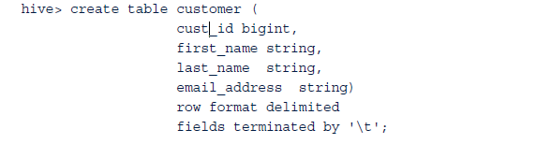

2.2 Hive 4/6
A user can define new tables, query them, or summarize their contents.
To create a table called customer to store customer details. Because the table will be populated from an existing tab (‘\t’)-delimited HDFS file, this format is specified in the table creation query.
HiveQL query is executed to count the number of records in the newly created table,
customer.

Slide 32
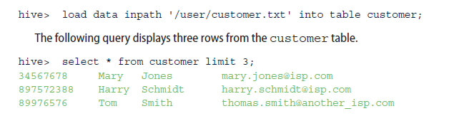
2.2 Hive 5/6
Hive outperforms and scales better than most conventional database queries when querying large tables
To load the customer table with the contents of HDFS file, customer.txt, it is only necessary to provide the HDFS directory path to the file.

Slide 33
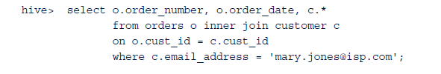


2.2 Hive 6/6
To exit the Hive interactive environment
Following are some Hive use cases:
Exploratory or ad-hoc analysis of HDFS data
Extracts or data feeds to reporting systems, dashboards, or data repositories such as HBase:
Combining external structured data to data already residing in HDFS:

Slide 34
2.3 HBase
Capable of providing real-time read and write access to datasets with billions of rows and millions of columns
HBase design is based on Google’s 2006 paper on Bigtable. Google used Bigtable to store Google product–specific data for sites such as Google Earth, which provides satellite images of the world. Bigtable was also used to store web crawler results, data for personalized search optimization, and website clickstream data. Bigtable was built on top of the Google File System
MapReduce was also utilized to process data into or out of a Bigtable. For example, the raw clickstream data was stored in a Bigtable. Periodically, a scheduled MapReduce job would run that would process and summarize the newly added clickstream data and append the results to a second Bigtable

Slide 35
HBase Architecture and Data Model 1/10
HBase is a data store that is intended to be distributed across a cluster of nodes.
Like Hadoop and many of its related Apache projects, HBase is built upon HDFS and achieves its real-time access speeds by sharing the workload over a large number of nodes in a distributed cluster An HBase table consists of rows and columns.
An HBase table also has a third dimension, version, to maintain the different values of a row and column intersection over time.

Slide 36
HBase Architecture and Data Model 2/10
Figure 10-6, the customer can then select the appropriate address, add a new address, or delete any addresses that are no longer relevant.
FIGURE 10-6 Choosing a shipping address at checkout

Slide 37
HBase Architecture and Data Model 3/10
HBase is built on top of HDFS. HBase uses a key/value structure to store the contents of an HBase table. Each value is the data to be stored at the intersection of the row, column, and version. Each key consists of the following elements
Row length
Row (sometimes called the row key)
Column family length
Column family
Column qualifier
Version
Key type

Slide 38
HBase Architecture and Data Model 4/10
Row is used as the primary attribute to access the contents of an HBase table. The row is the basis for how the data is distributed across the cluster and allows a query of an HBase table to quickly retrieve the desired elements
A column in an HBase table is designated by the combination of the column family and the column qualifier
A cell is the intersection of a row and a column in a table. The version, sometimes called the timestamp, provides the ability to maintain different values for a cell’s contents in Hbase
Key type is used to identify whether a particular key corresponds to a write operation to the Hbase table or a delete operation from the table. Technically, a delete from an HBase table is accomplished with a write to the table. The key type indicates the purpose of the write. For deletes, a tombstone marker is written to the table to indicate that all cell versions equal to or older than the specified timestamp should be deleted for the corresponding row and column family:column qualifier.

Slide 39
HBase Architecture and Data Model 5/10
User can enter the HBase shell environment by entering hbase shell at the command prompt.
create : create a new table in HBase. table- my_table can then be created as follows:
Table has two column families, cf1 and cf2.
SPLITS option specifies how the table will be divided based on the row portion of the key.
Table is split into four parts, called regions. Rows less than 250000 are added to the first region; rows from 250000 to less than 500000 are added to the second region, and likewise for the remaining splits.

Slide 40
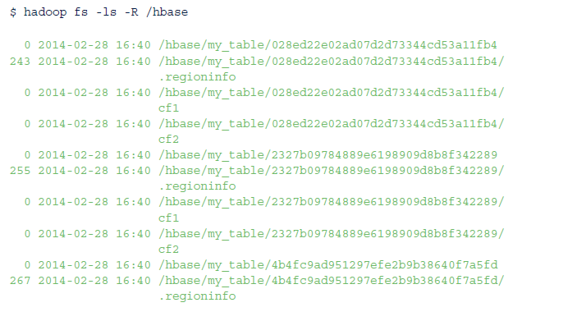
HBase Architecture and Data Model 6/10
Column families help to define how the table will be physically stored.
HBase table is split into regions, but each region is split into column families that are stored separately in HDFS.
hadoop fs -ls -R /hbase shows how the HBase table, my_table, is stored in HBase.

Slide 41
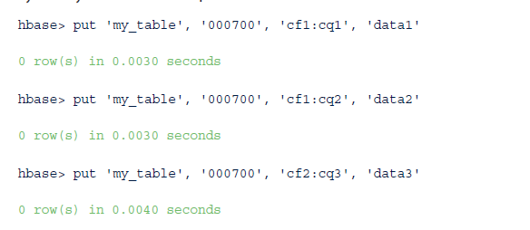
HBase Architecture and Data Model 7/10
put command : Add data operation to the table.
Example: three put operations, data1 and data2 are entered into column qualifiers, cq1 and cq2, respectively, in column family cf1. The value data3 is entered into column qualifier cq3 in column family cf2. The row is designated by row key 000700 in each operation.

Slide 42
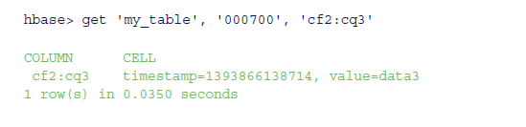
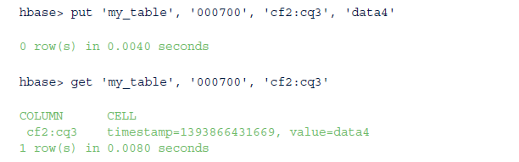
HBase Architecture and Data Model 8/10
get command: Retrieve data from HBase table. Get command returns the most recent version by default
Note : the timestamp defaults to the milliseconds since January 1, 1970.
Example: After executing a second put operation in the same row and column, a subsequent get provides the most recently added value of data4.

Slide 43
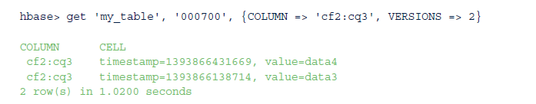
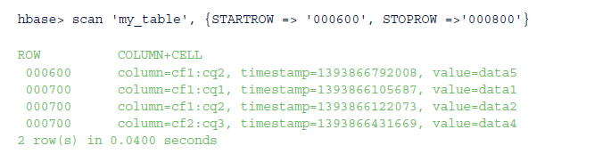
HBase Architecture and Data Model 9/10
Get operation can provide multiple versions by specifying the number of versions to retrieve.
This example illustrates that the cells are presented in descending version order.
A similar operation to the get command is scan. A scan retrieves all the rows between a specified
STARTROW and a STOPROW, but excluding the STOPROW. Note: if the STOPROW was set to 000700,
only row 000600 would have been returned.

Slide 44
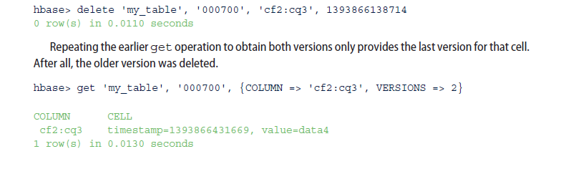
HBase Architecture and Data Model 10/10
delete command: delete data in the table
E.g. deletes the oldest entry for column cf2:cq3 for row 000700 by specifying the timestamp.
However, running a scan operation, with the RAW option set to true, reveals that the deleted entry
actually remains. The highlighted line illustrates the creation of a tombstone marker, which informs the
default get and scan operations to ignore all older cell versions of the particular row and column.

Slide 45
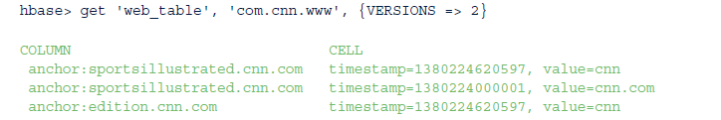
Use Cases for Hbase
Results from a web crawler : As described in Google’s Bigtable paper, a common use case for a data store such as HBase is to store the results from a web crawler.
The storage and search access of messages. In 2010, Facebook implemented such a system using HBase. At the time, Facebook’s system was handling more than 15 billion user-to-user messages per month and 120 billion chat messages per month.
The row was defined to be the user ID.
The column qualifier was set to a word that appears in the message.
The version was the message ID.
The cell’s content was the offset of the word in the message.

Slide 46
Other HBase Usage Considerations
Following considerations are important for a successful implementation.
Java API
Column family and column qualifier names
Defining rows
Avoid creating sequential rows
Versioning control
Zookeeper:

Slide 47
2.4 Mahout 1/2
To apply the analytical techniques within the Hadoop environment, an option is to use Apache Mahout.
Provides executable Java libraries to apply analytical techniques in a scalable manner to Big Data. It is the toolset that directs Hadoop, the elephant in this case, to yield meaningful analytic results.
Mahout provides Java code that implements the algorithms for several techniques in the following three categories
Classification:
Logistic regression
Naïve Bayes
Random forests
Hidden Markov models

Slide 48
2.4 Mahout 2/2
Clustering:
Canopy clustering
K-means clustering
Fuzzy k-means
Expectation maximization (EM)
Recommenders/collaborative filtering:
Nondistributed recommenders
Distributed item-based collaborative filtering

Slide 49
Pivotal HD Enterprise with HAWQ 1/2
Pivotal HD Enterprise includes several Apache software components that have been presented in this chapter.
Additional Apache software includes the following:
Oozie: Manages Apache Hadoop jobs by acting as a workflow scheduler system
Sqoop: Efficiently moves data between Hadoop and relational databases
Flume: Collects and aggregates streaming data (for example, log data)

Slide 50
Pivotal HD Enterprise with HAWQ 2/2
Pivotal includes the following:
Command Center
Graphlab on Open MPI (Message Passing Interface)
Hadoop Virtualization Extensions (HVE)
HAWQ (HAdoop With Query)
FIGURE 10-7 Components of Pivotal HD Enterprise

Slide 51
3 NoSQL 1/2
NoSQL (Not only Structured Query Language) is a term used to describe those data stores that are applied to unstructured data.
HBase is such a tool that is ideal for storing key/values in column families.
Power of NoSQL data stores is that as the size of the data grows, the implemented solution can scale by simply adding additional machines to the distributed system
Four major categories of NoSQL tools
Key/value stores
Document stores
Column family stores
Graph databases

Slide 52
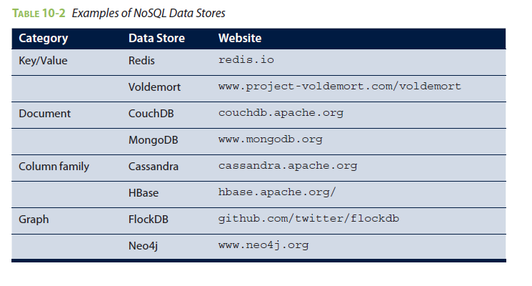
3 NoSQL 2/2

Slide 53
Summary 1/3
MapReduce paradigm and its application in Big Data analytics. Specifically, it examined the implementation of MapReduce in Apache Hadoop
Power of MapReduce is realized with the use of the Hadoop Distributed File System (HDFS) to store data in a distributed system
The ability of run a MapReduce job on the data stored across a cluster of machines enables the parallel processing of petabytes or exabytes of data. Furthermore, by adding additional machines to the cluster, Hadoop can scale as the data volumes grow.
Examined several Apache projects within the Hadoop ecosystem. By providing a higherlevel programming language, Apache Pig and Hive simplify the code development by masking the underlying MapReduce logic to perform common data processing tasks such as filtering, joining datasets, and restructuring data. Once the data is properly conditioned within the Hadoop cluster, Apache Mahout can be used to conduct data analyses such as clustering, classification, and collaborative filtering.

Slide 54
Summary 2/3
The strength of MapReduce in Apache Hadoop and the so far mentioned projects in the Hadoop ecosystem are in batch processing environments. When real-time processing, including read and writes, are required, Apache HBase is an option. HBase uses HDFS to store large volumes of data across the cluster, but it also maintains recent changes within memory to ensure the real-time availability of the latest data.
Whereas MapReduce in Hadoop, Pig, and Hive are more general-purpose tools that can address a wide range of tasks, HBase is a somewhat more purpose-specific tool. Data will be retrieved from and written to the HBase in a well-understood manner.

Slide 55
Summary 3/3
HBase is one example of the NoSQL (Not only Structured Query Language) data stores that are being developed to address specific Big Data use cases. Maintaining and traversing social network graphs are examples of relational databases not being the best choice as a data store. However, relational databases and SQL remain powerful and common tools and will be examined in more detail in Chapter 11

